Slide 1
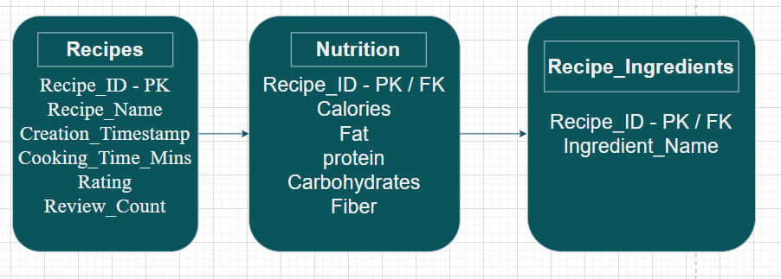
Recipe Master
Project Objective:
The Recipe Master Project is a database-driven management system designed to organize, analyse, and store culinary data. The project transitioned from a flat CSV file containing 200 diverse recipes into a structured, relational SQL database to improve data integrity, searchability, and scalability.
Recipes Table: Stores core identity and metadata (Names, IDs, Ratings, Timestamps).
Nutrition Table: Stores health-specific data (Calories, Macros, Cholesterol).
Ingredients Table: A one-to-many table allowing for granular searching of individual ingredients.
ERD Diagram:

